Slide 1
Digital Portfolio
STUDENT NAME: Kamalnath.N
REGISTER NO AND NMID: autunm11024ca106
DEPARTMENT: Computer Application
COLLEGE: University of Madras

Slide 2
PROJECT TITLE
PORTFOLIO WEBSITE

Slide 3


AGENDA
Problem Statement
Project Overview
End Users
Tools and Technologies
Portfolio design and Layout
Features and Functionality
Results and Screenshots
Conclusion
Github Link
3/21/2024 Annual Review

Slide 4

PROBLEM STATEMENT
.
Traditional resumes fail to showcase creativity, visual skills, and interactive projects.
Clients and recruiters often prefer interactive and visual portfolios to understand skills.
There is a need for a modern, dynamic, and creative platform that reflects my skills in video editing and UI/UX design.

Slide 5

PROJECT OVERVIEW
The project is a personal portfolio website designed to highlight my work.
Includes an About Me section to present my background.
A Skills section to showcase expertise in editing and design tools.
Projects section with real examples of my work.
Interactive Contact section to connect with recruiters, clients, and collaborators.

Slide 6

WHO ARE THE END USERS?
Clients & Businesses: Looking for professional video editing and design services.
Recruiters & Hiring Managers: Evaluate my skills for job opportunities.
Design Community: Fellow UI/UX designers and editors for collaboration.
General Audience: Anyone interested in my creative journey and work samples.

Slide 7

TOOLS AND TECHNIQUES
HTML5, CSS3, JavaScript for building interactive pages.
Design & Editing Tools:
Adobe Premiere Pro, After Effects, Photoshop, Illustrator.
Figma and Sketch for UI/UX wireframing and prototyping.
Hosting & Version Control:
GitHub Pages for free hosting.
GitHub for project management and collaboration.

Slide 8
POTFOLIO DESIGN AND LAYOUT
Designed with modern UI principles: clean typography, bold colors, and responsive layouts.
Hero Section: Typing animation + floating profile image for a strong first impression.
About Section: Personal story + passion for design and editing.
Projects Section: 3D tilt hover animation to make project previews interactive.
Skills Section: Animated skill cards with hover effects for better engagement.
Contact Section: Social icons styled with animations for easy networking.
.
8

Slide 9
FEATURES AND FUNCTIONALITY
Responsive design (works on desktop, tablet, and mobile).
Animated typing effect for roles.
Interactive hover effects on skills and projects.
Contact form with validation.
Social media icons with links (GitHub, LinkedIn, Email).
Smooth scrolling navigation.

Slide 10
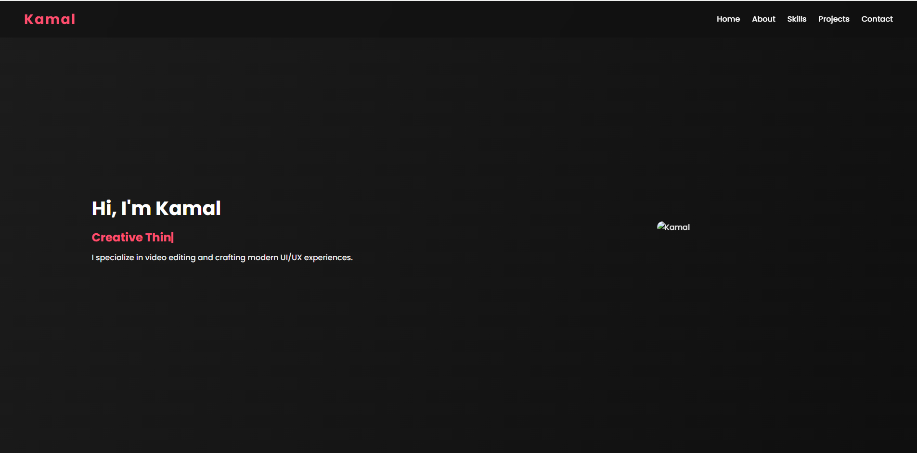
RESULTS AND SCREENSHOTS
3/21/2024 Annual Review
10

Slide 11
CONCLUSION
The portfolio effectively presents personal branding.
Enhances chances of job opportunities and collaborations.
Easily maintainable and extendable.
11

Slide 12
Github Link
https://github.com/nkamalnathnkamalnath-cmd/TNSDC-FWD-DP.git

